Slide 1
Real Electricity Nodal Prices
Coherence with 60% allowable CO2 and 50% allowable CO2

Slide 2
General notes on the networks
Real ENP needs 7 PC to describe >95% variance
60% allowable CO2 network needs 9 PC to describe >95% variance
50% allowable CO2 network needs 9 PC to describe >95% variance
60% and 50% allowable CO2 networks are almost identical in terms of PC for nodal prices
Real data: Bosnia-Herzegovina (BA) left out

Slide 3
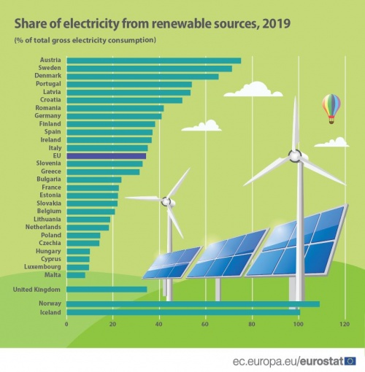
About the energy, electricity and heating
Energy
In 2019, renewable energy represented 19.7 % of energy consumed in the EU-27.
Electricity
In 2019, renewable energy sources made up 34 % of gross electricity consumption in the EU-27.
Heating
In 2019, renewable energy accounted for 22.1 % of total energy use for heating and cooling in the EU-27.

Slide 4
About the prices
Highest Real prices [€/MWh]
Country | Prices
RO | 730.38
IE | 378.12
GB | 350.00
EE | 255.03
LT | 255.03
Average prices [€/MWh]
Real: 40.1403
60%: 53.0914
50%: 53.0915
Minimum prices [€/MWh]
Real: -115.31
60%: 0.0099965
50%: 0.0099968
Maximum prices [€/MWh]
Real: 730.38
60%: 1000
50%: 1000
Romania is the country with the highest price of 730 [€/MWh]
Both 60% and 50% have prices at 1000 [€/MWh] for all countries at some point in time.
Have been artificially capped at 1000

Slide 5
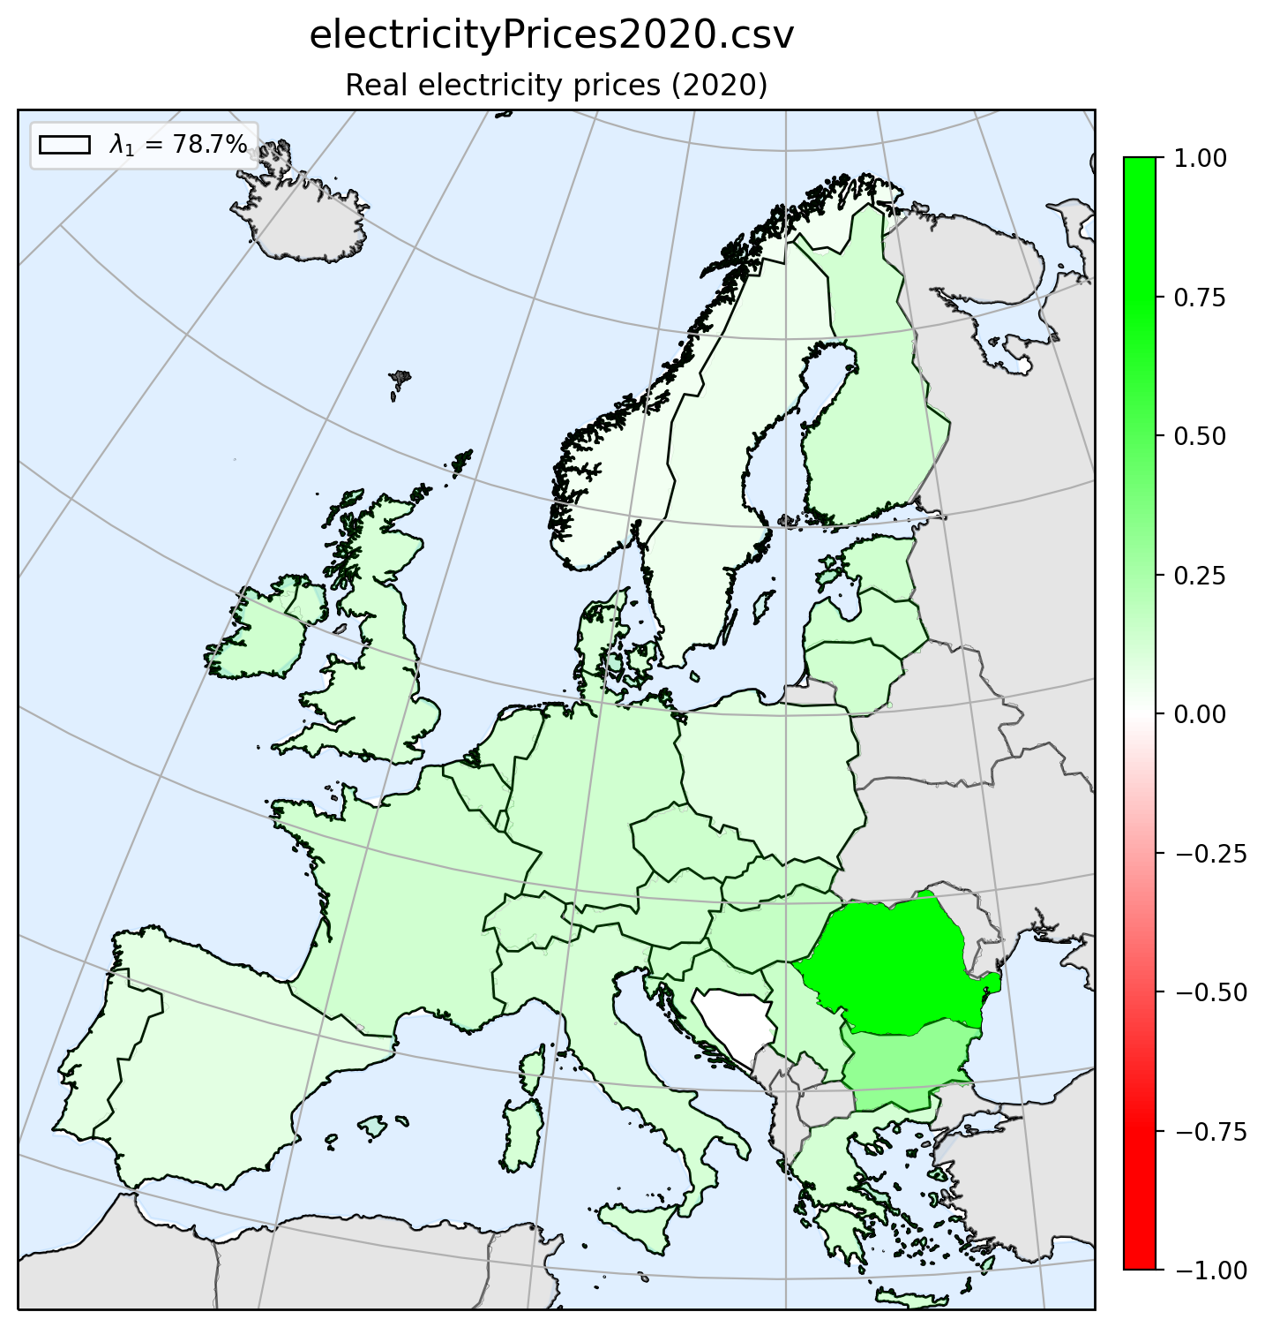
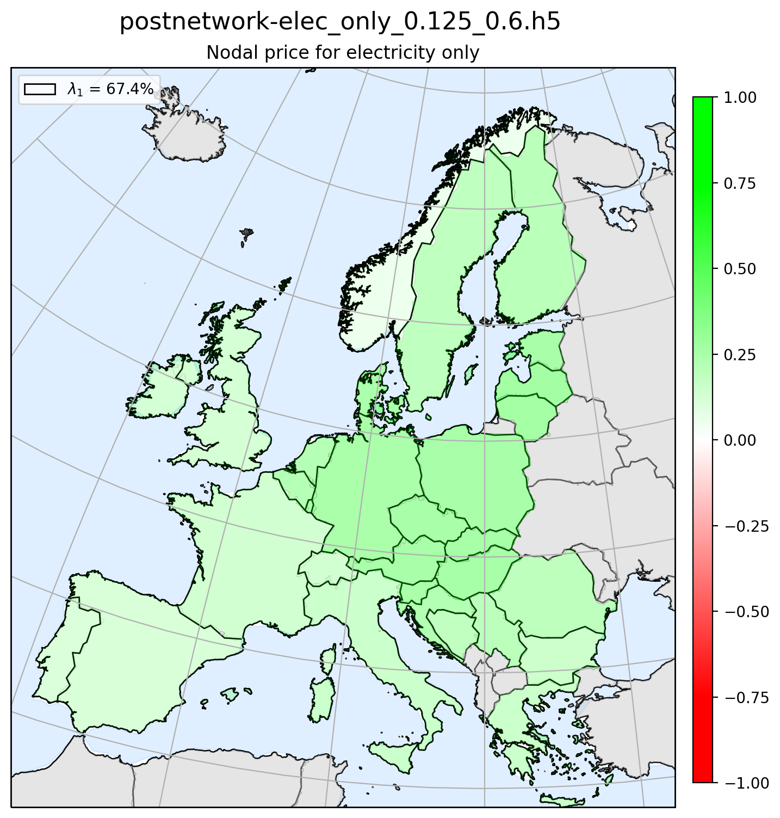
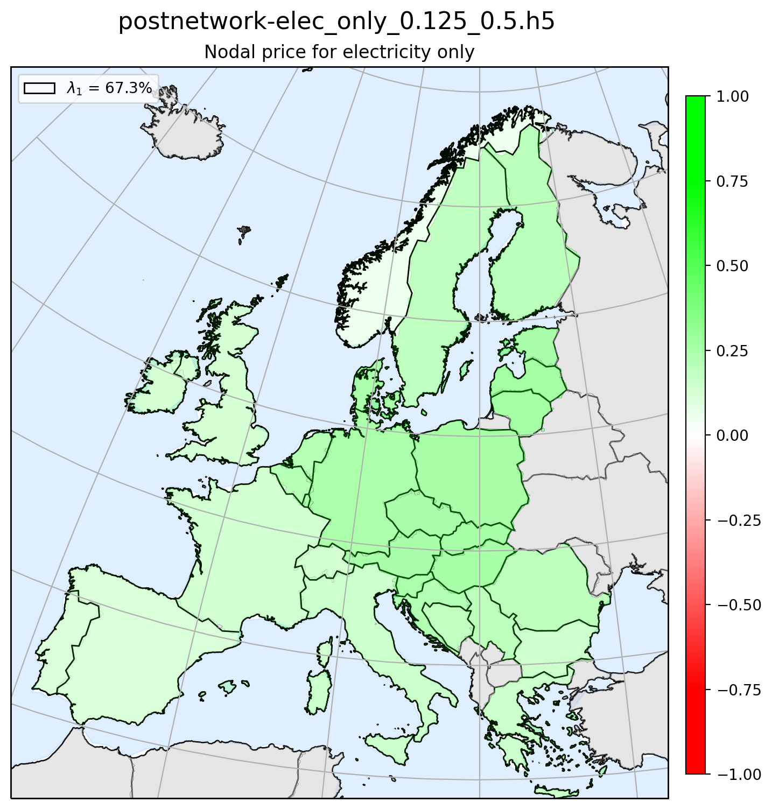
Principal component 1 – Map plot PC
Romania is the most green. This country is also the one with a price of 730 [€/MWh]
Both 60% and 50% have prices at 1000 [€/MWh] for all countries at some point in time.

Slide 6
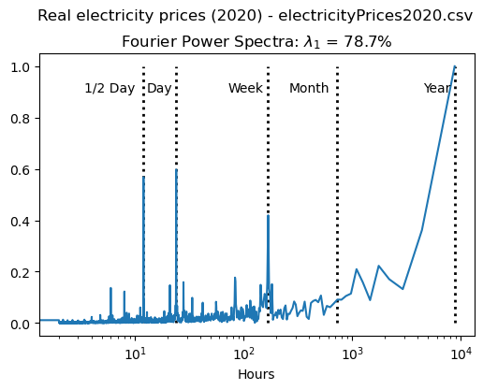
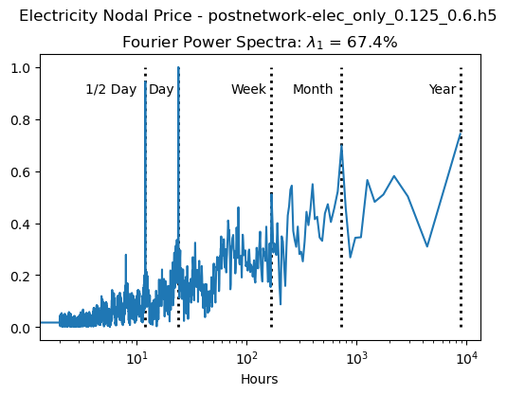

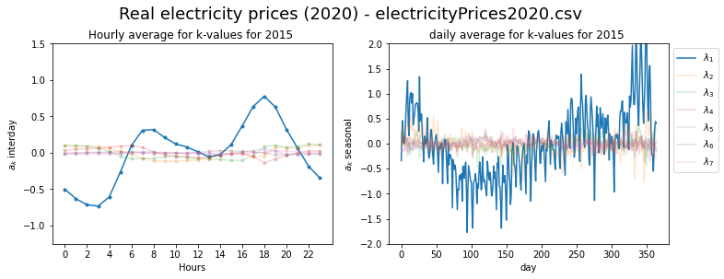
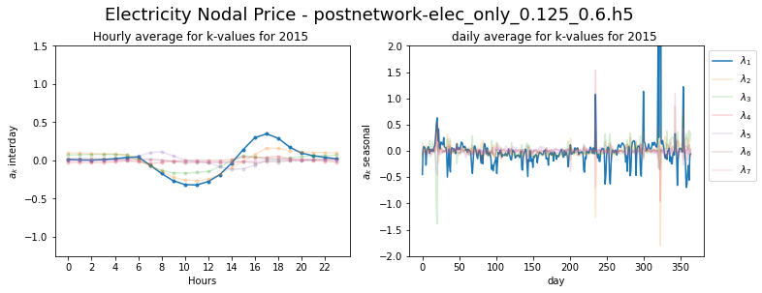

Principal component 1 – FFT and seasonal

Slide 7
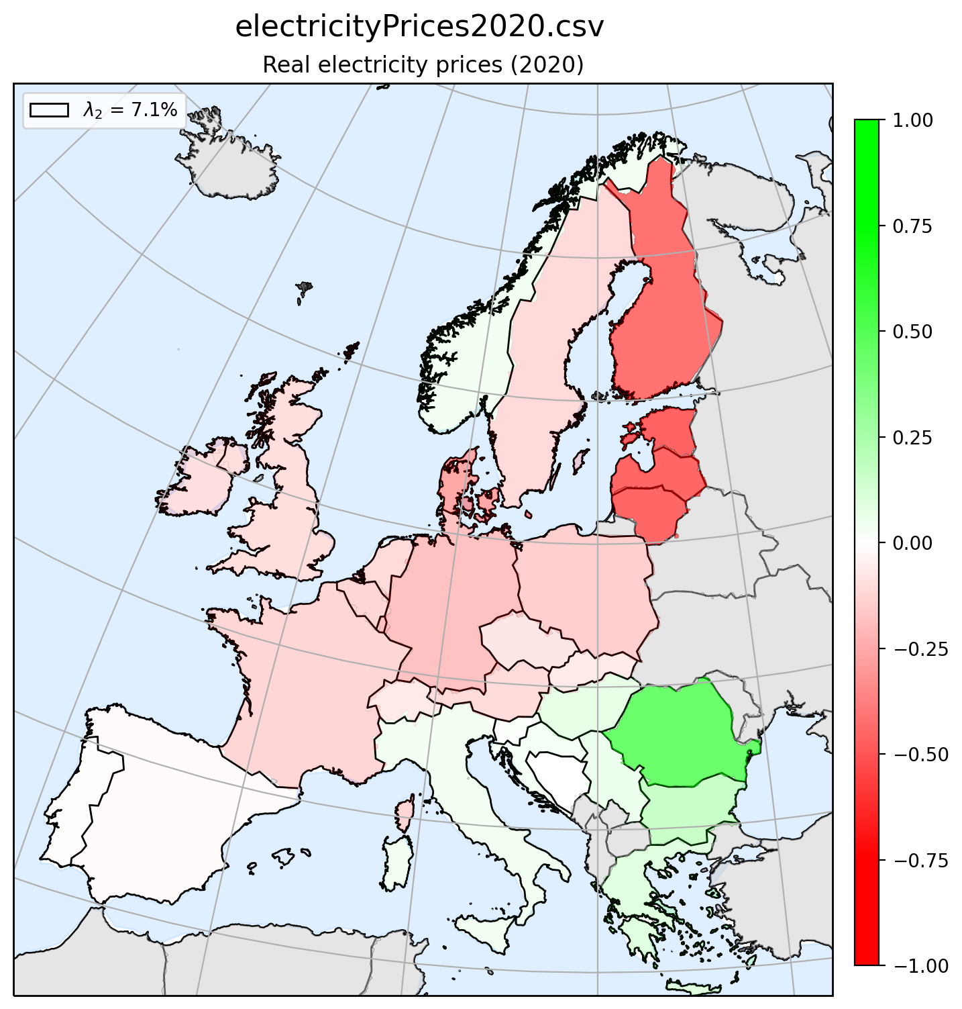
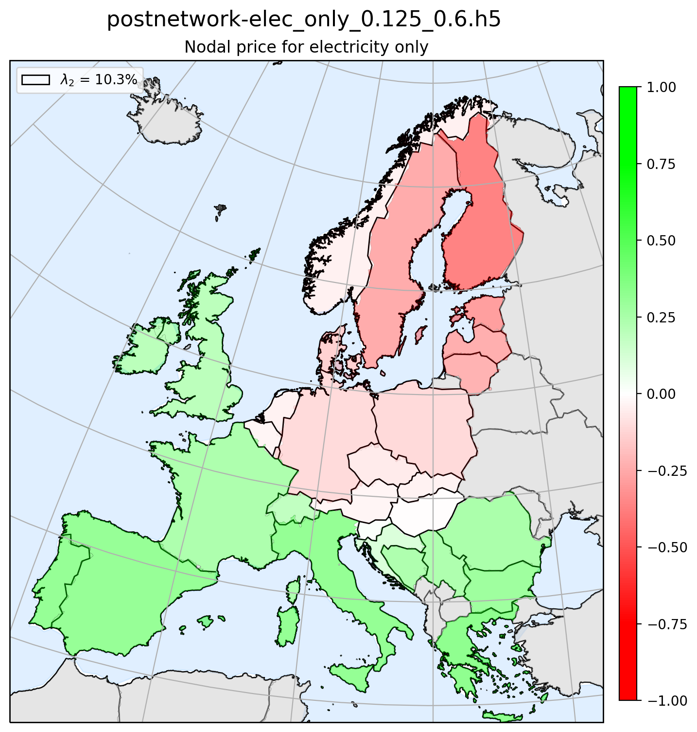

Principal component 2 – Map plot PC

Slide 8
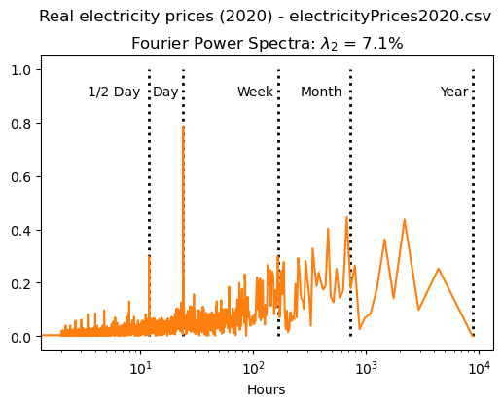
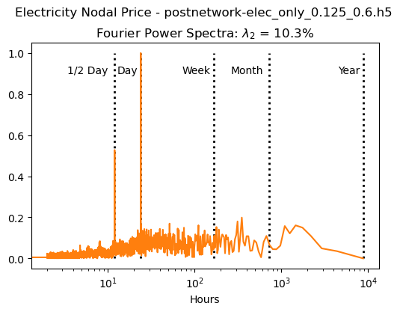

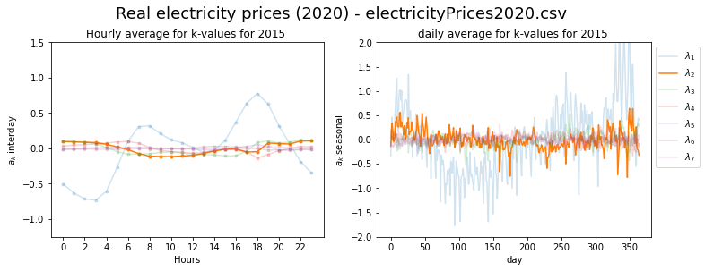
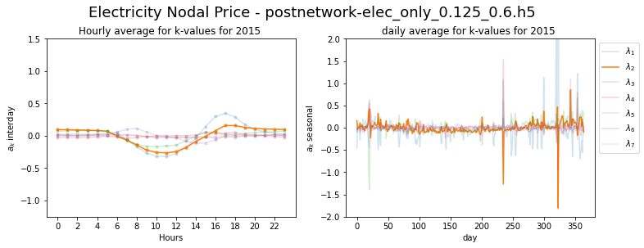

Principal component 2 – FFT and seasonal

Slide 9
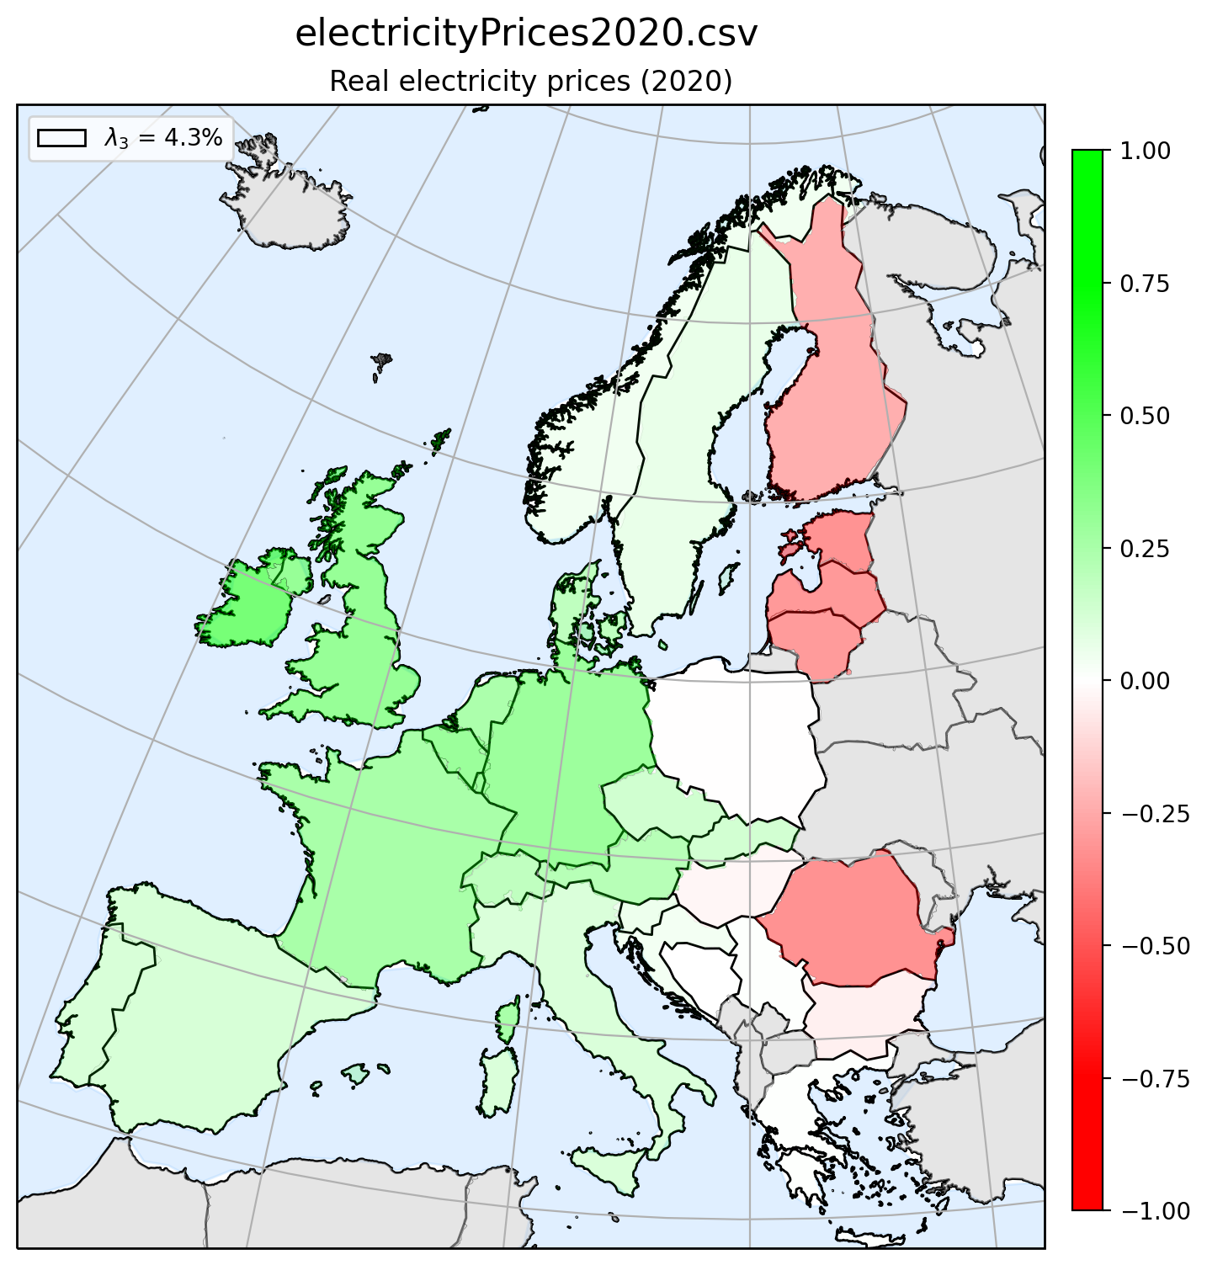
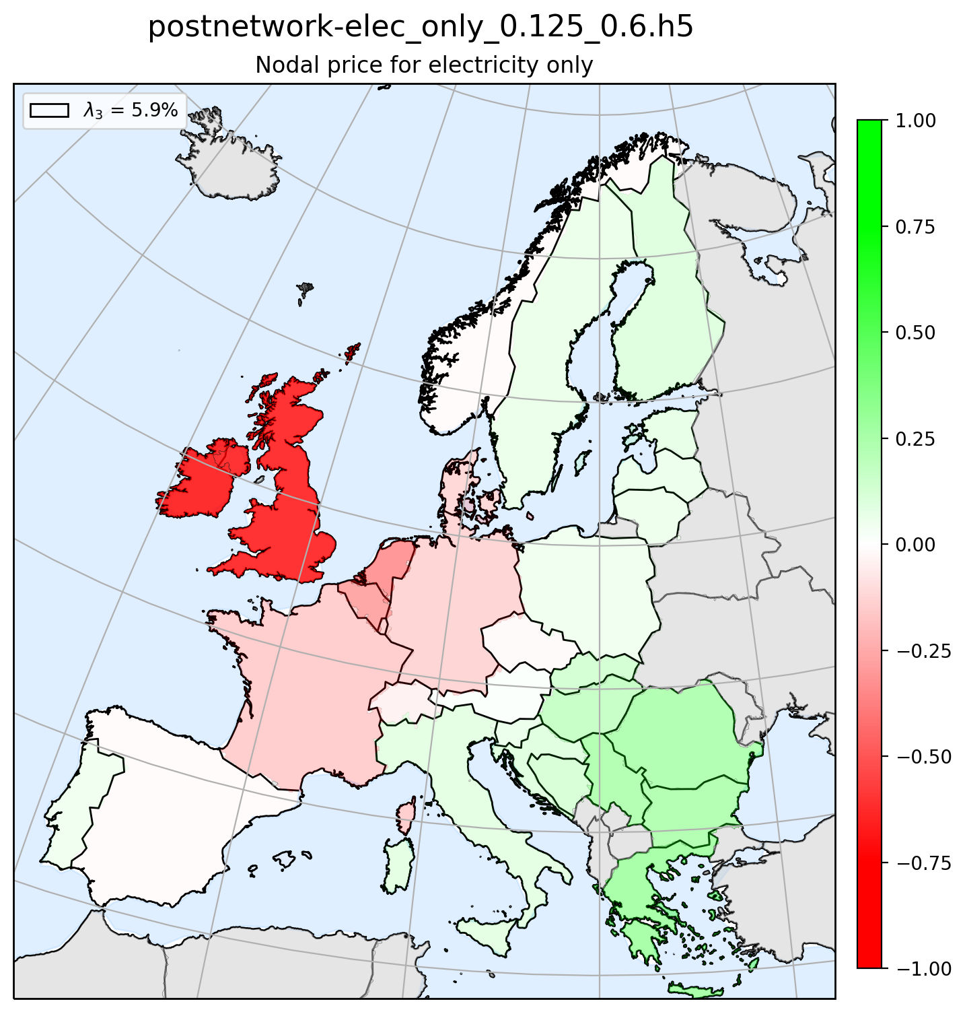

Principal component 3 – Map plot PC

Slide 10
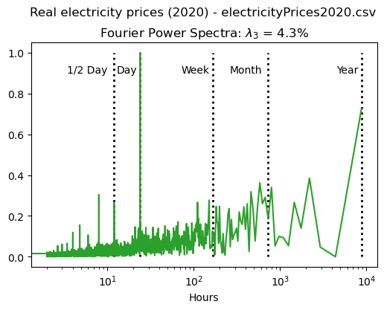
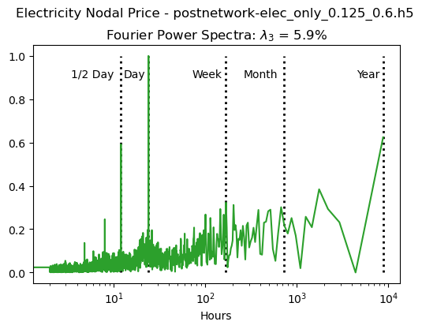

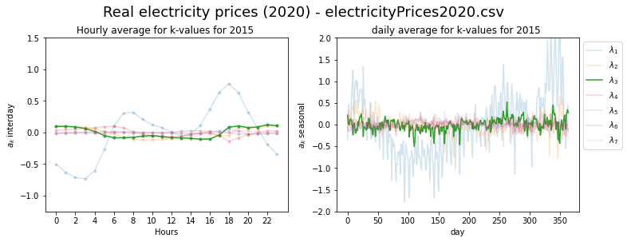
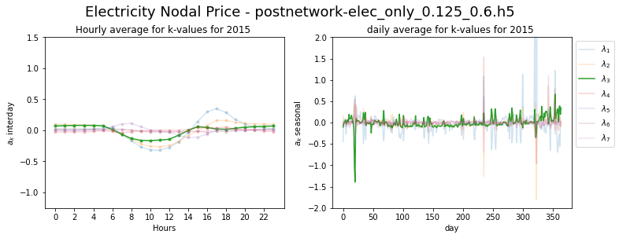

Principal component 3 – FFT and seasonal

Slide 11
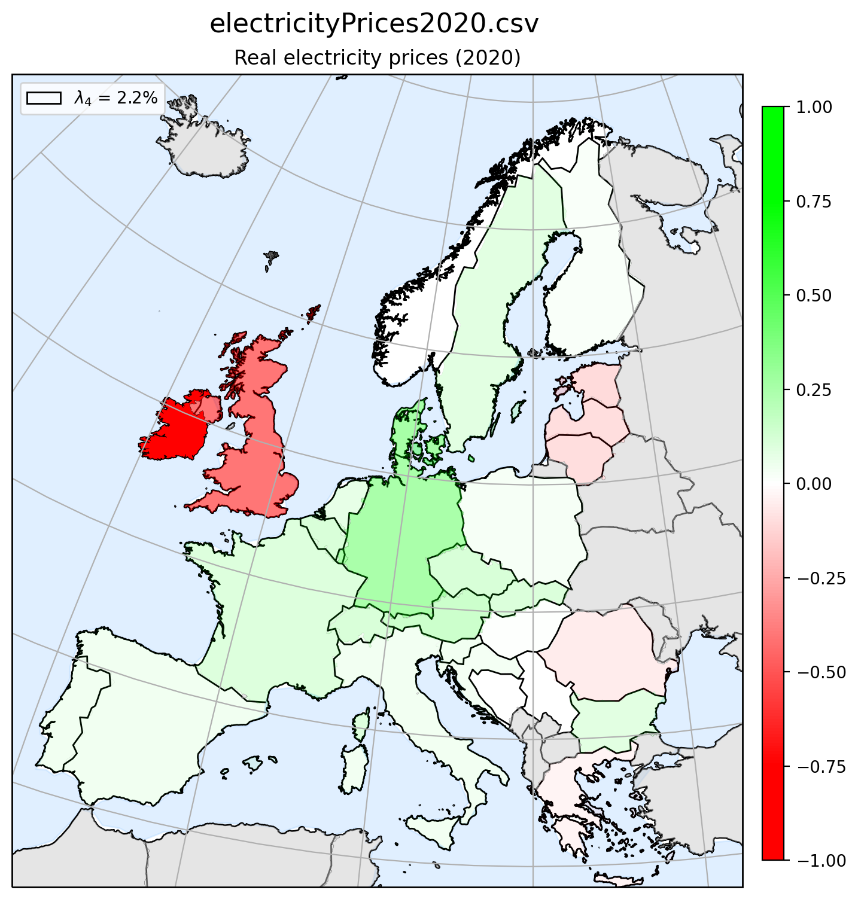
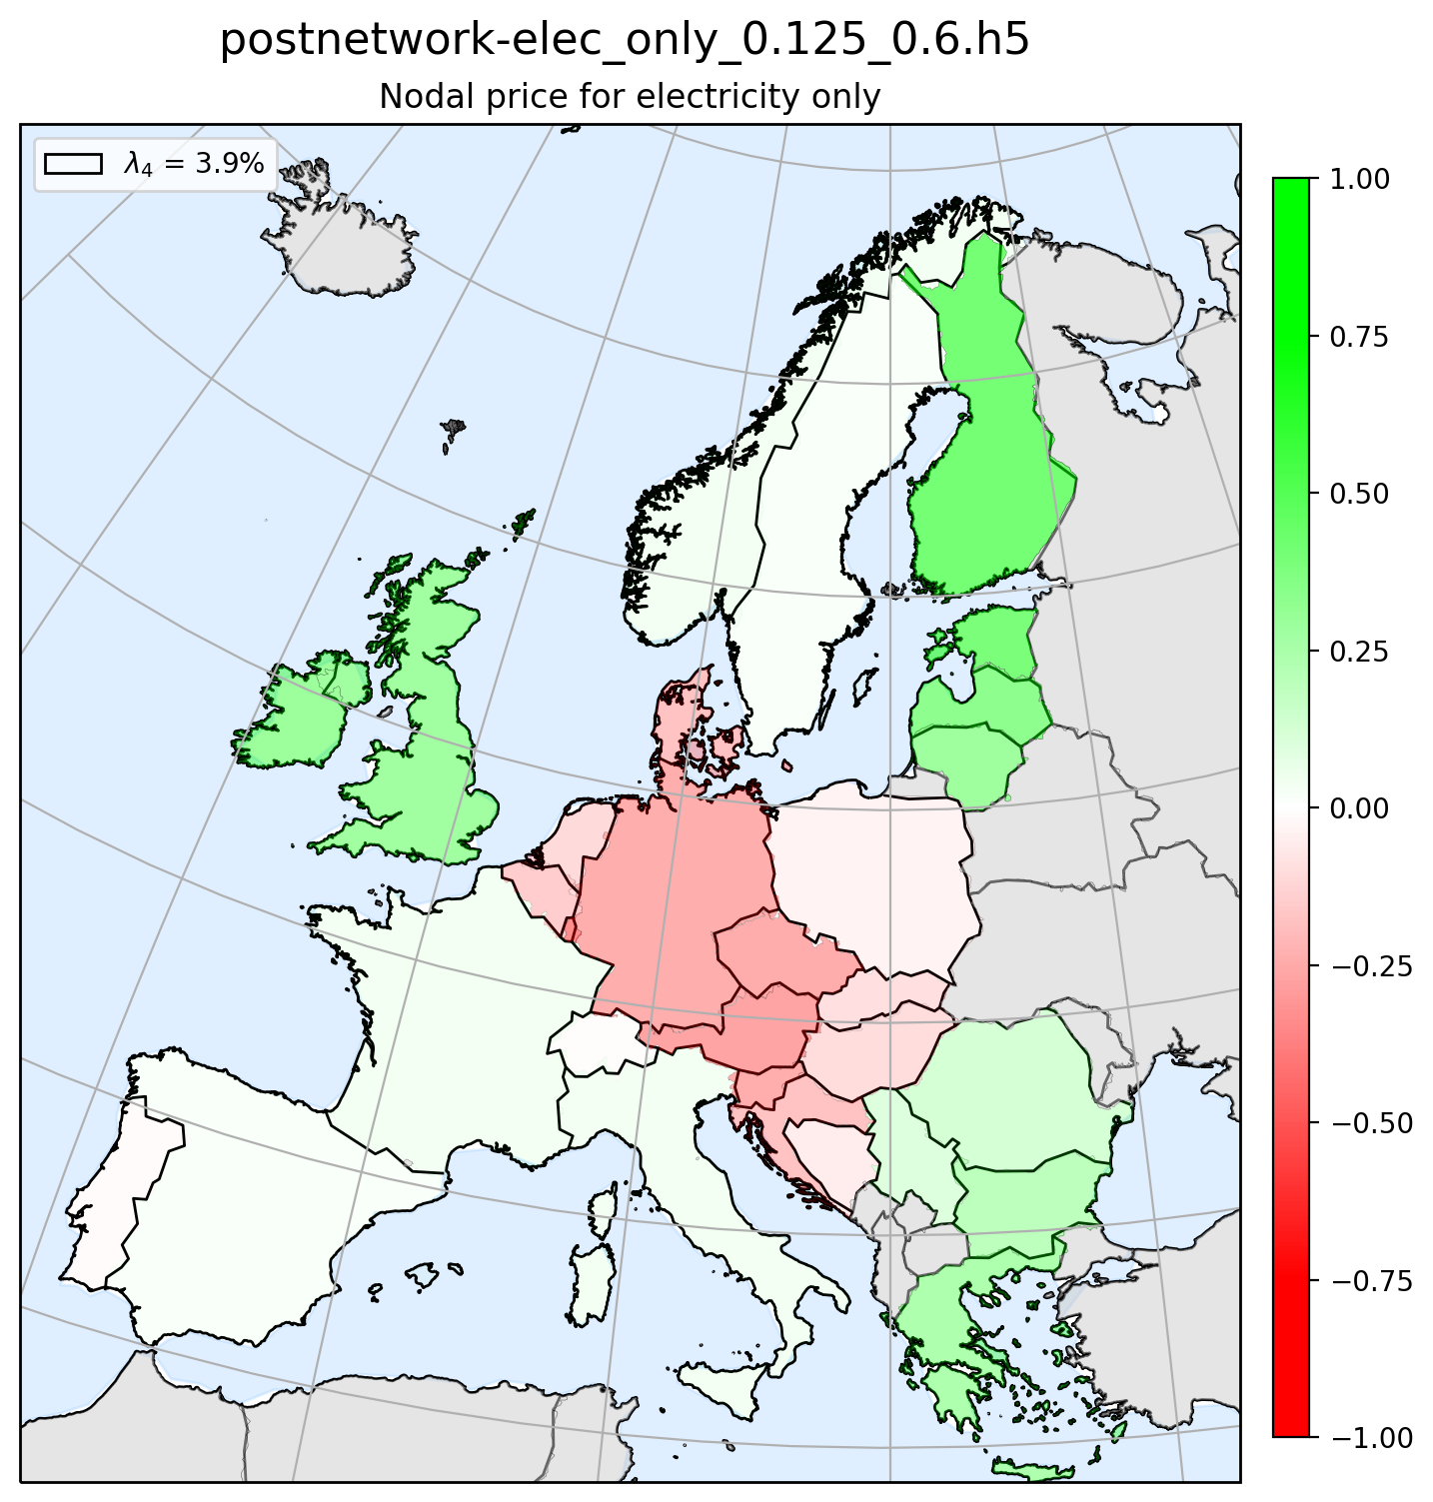

Principal component 4 – Map plot PC

Slide 12
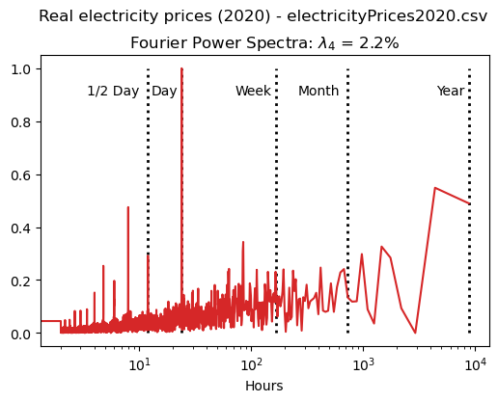
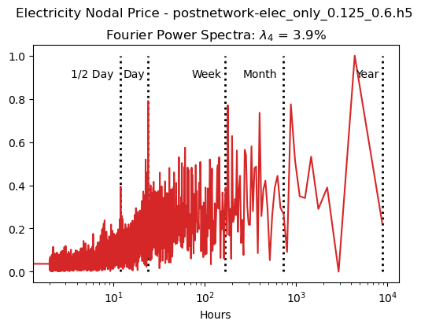

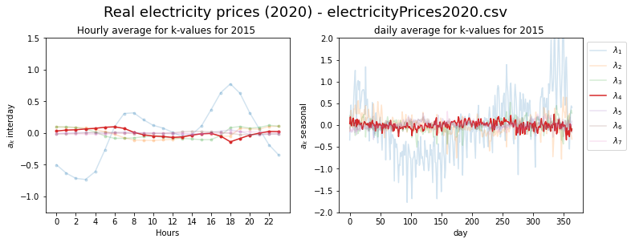
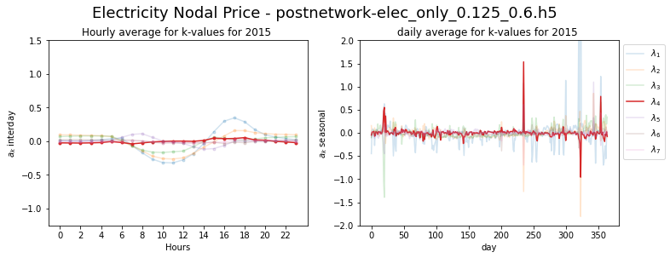

Principal component 4 – FFT and seasonal

Slide 13
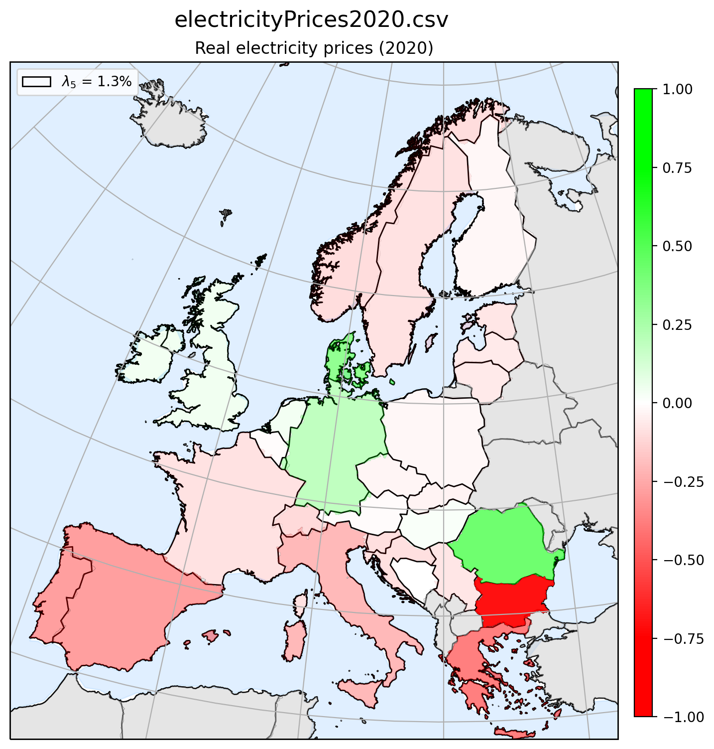
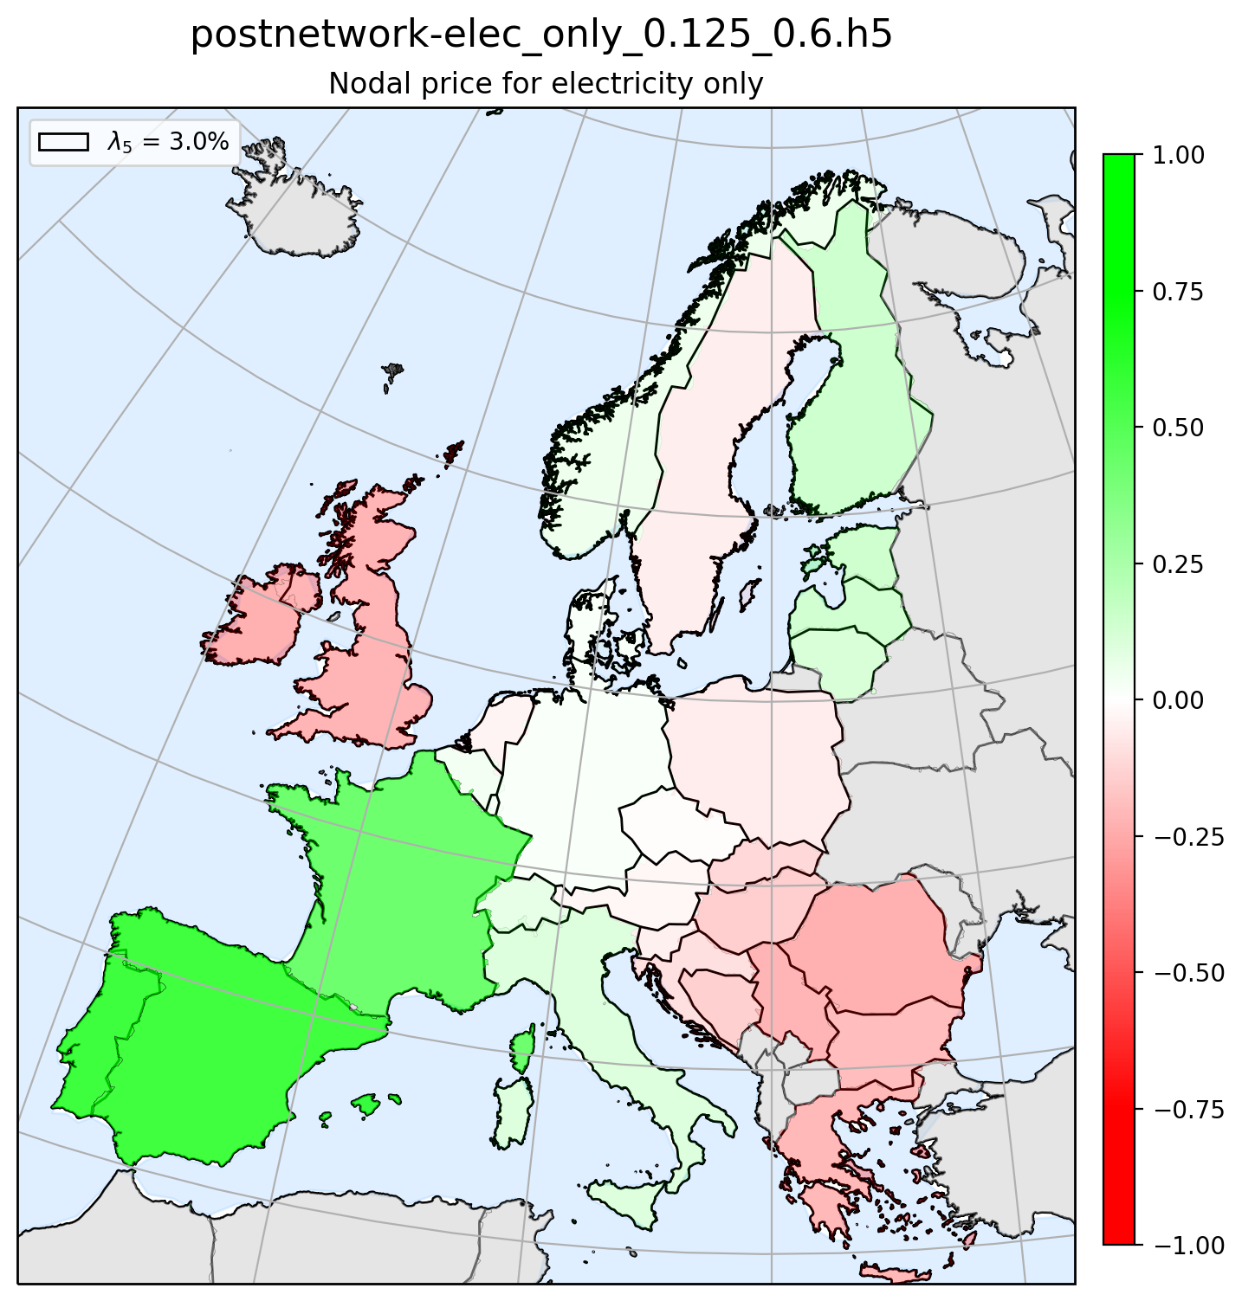
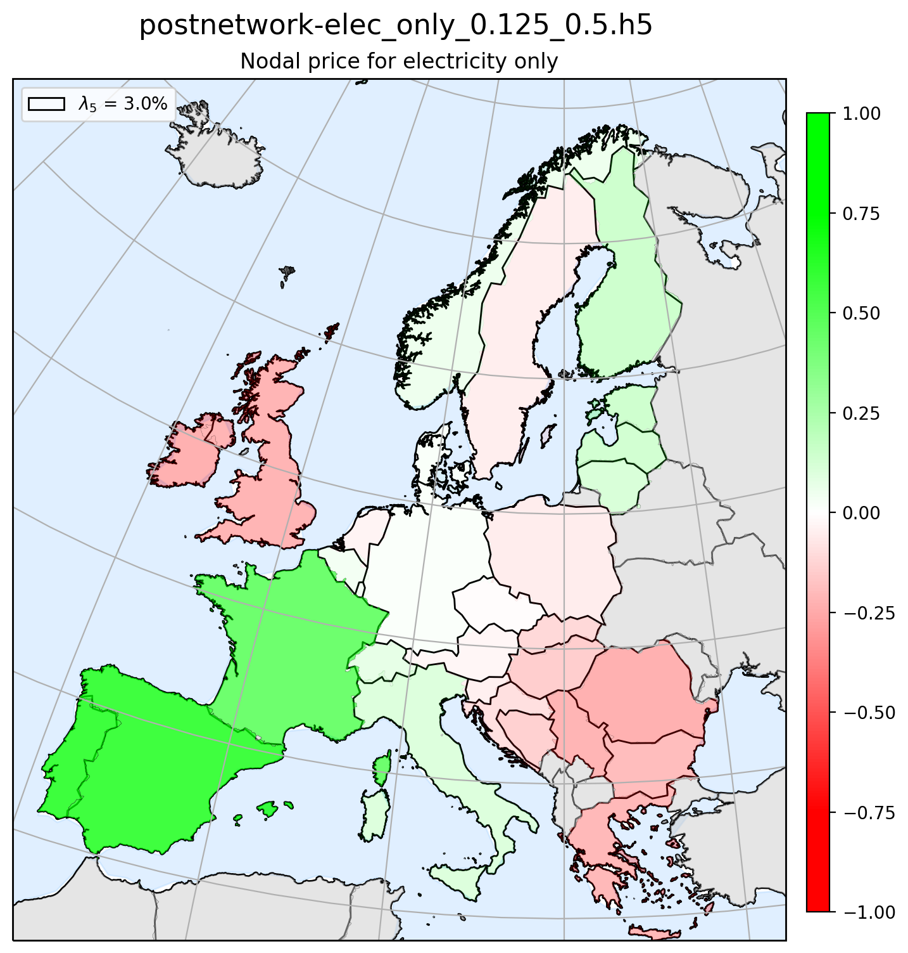
Principal component 5 – Map plot PC

Slide 14
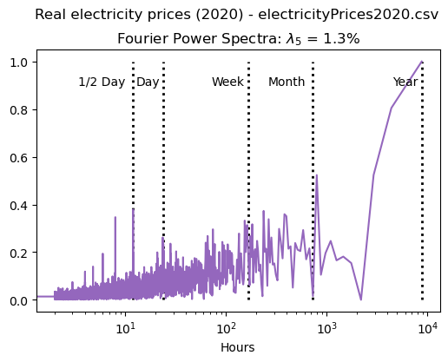
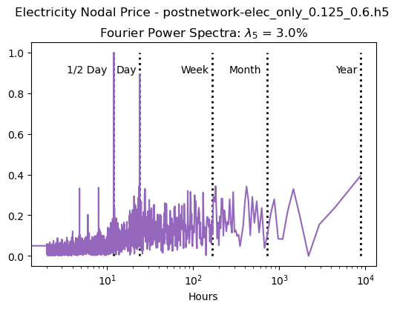

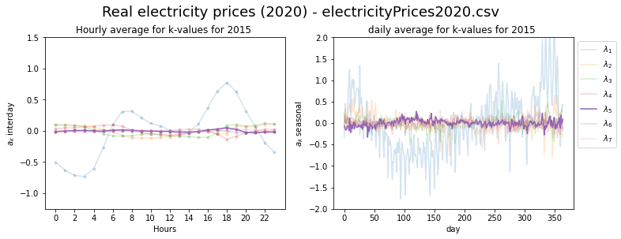
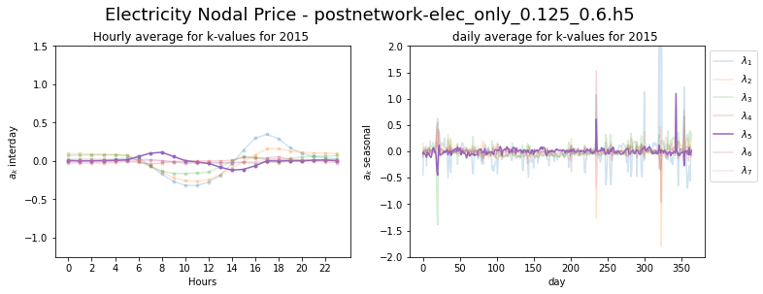
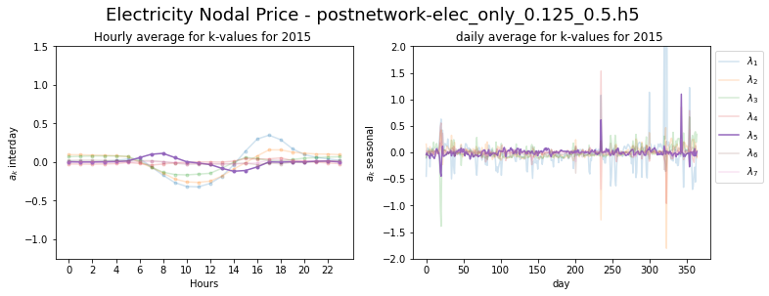
Principal component 5 – FFT and seasonal

Slide 15
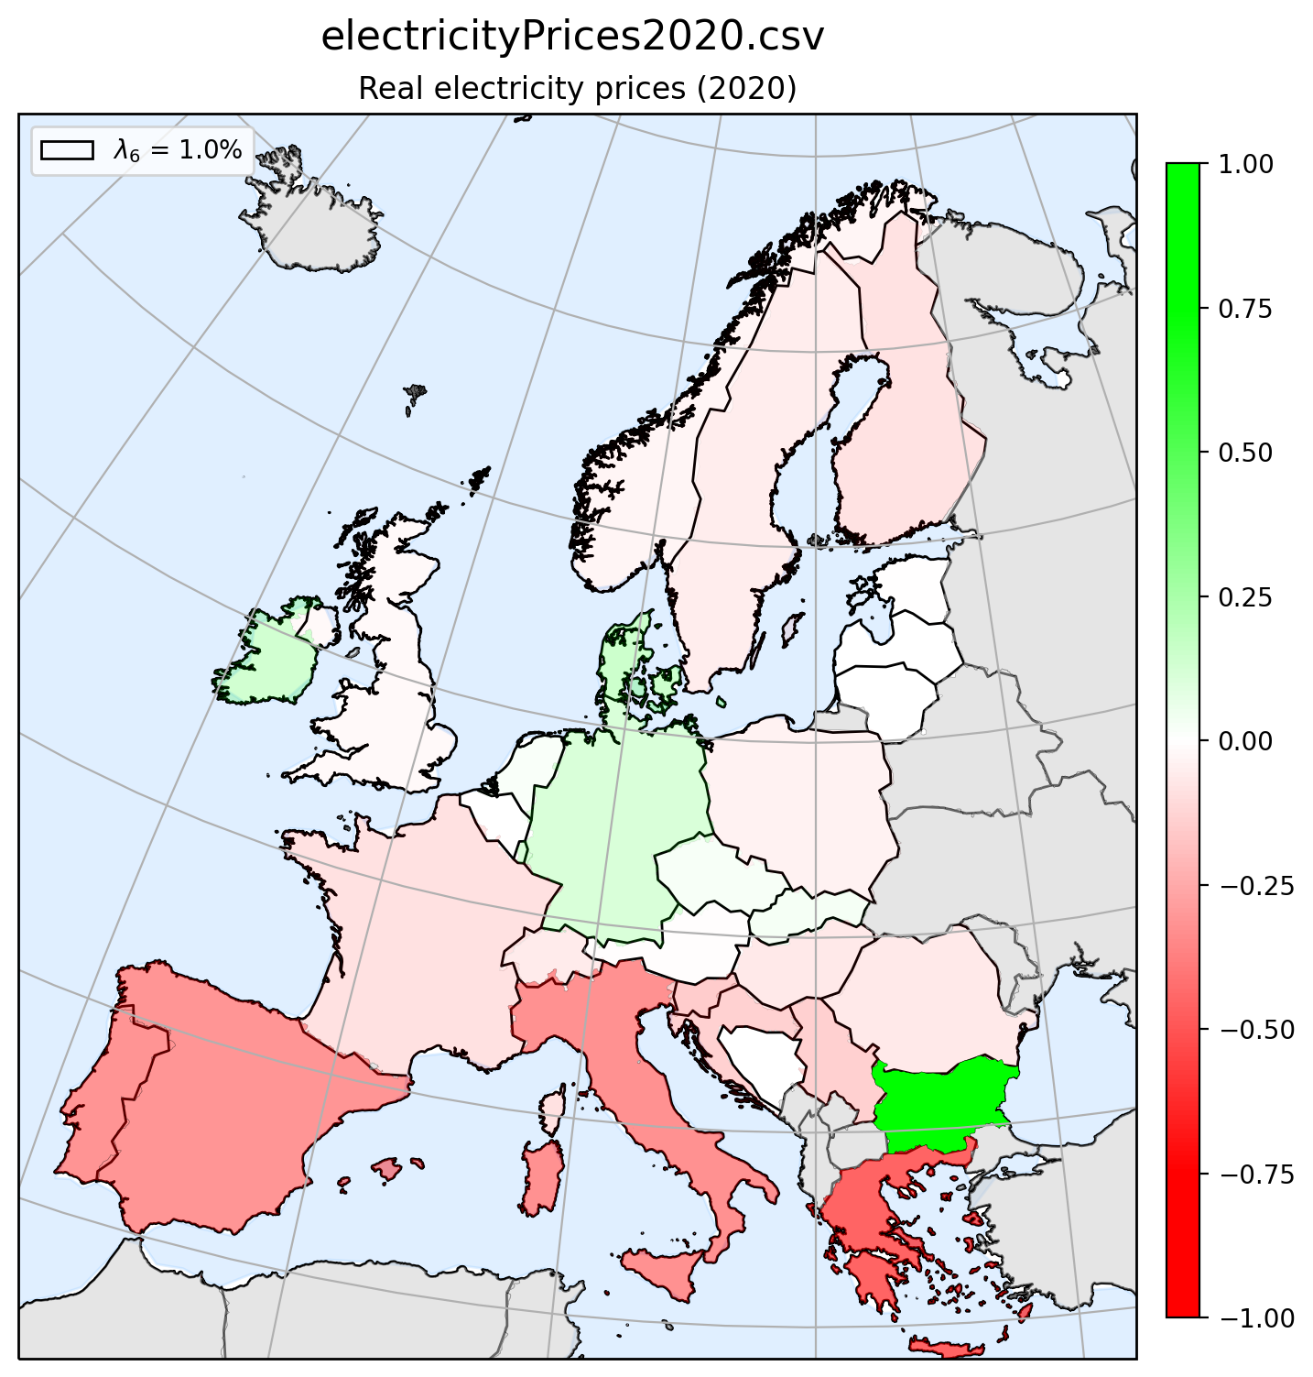
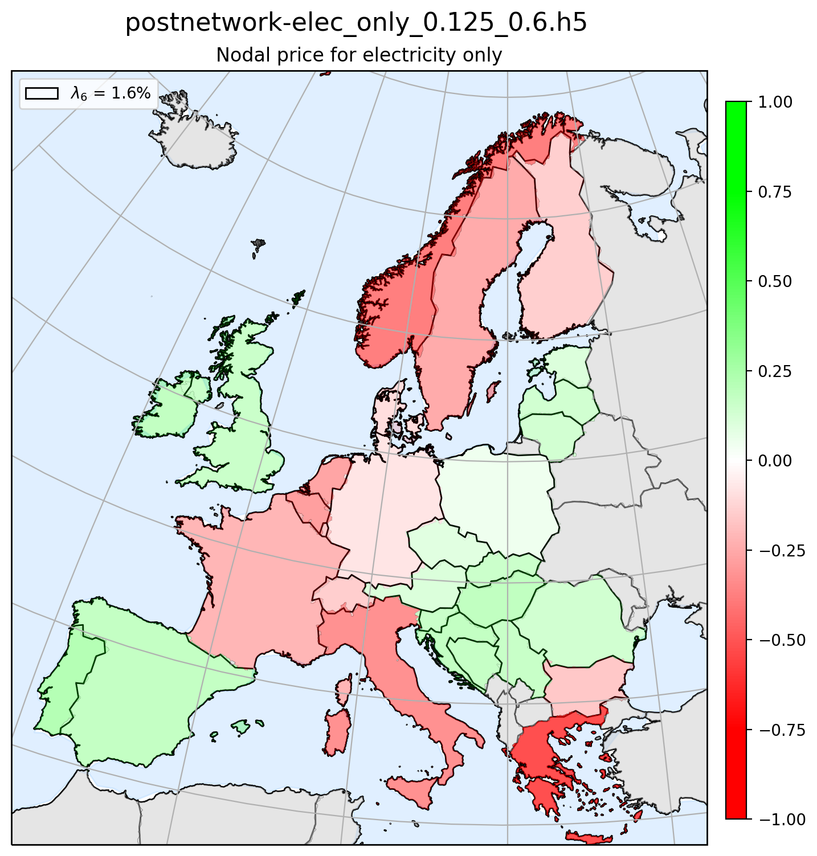
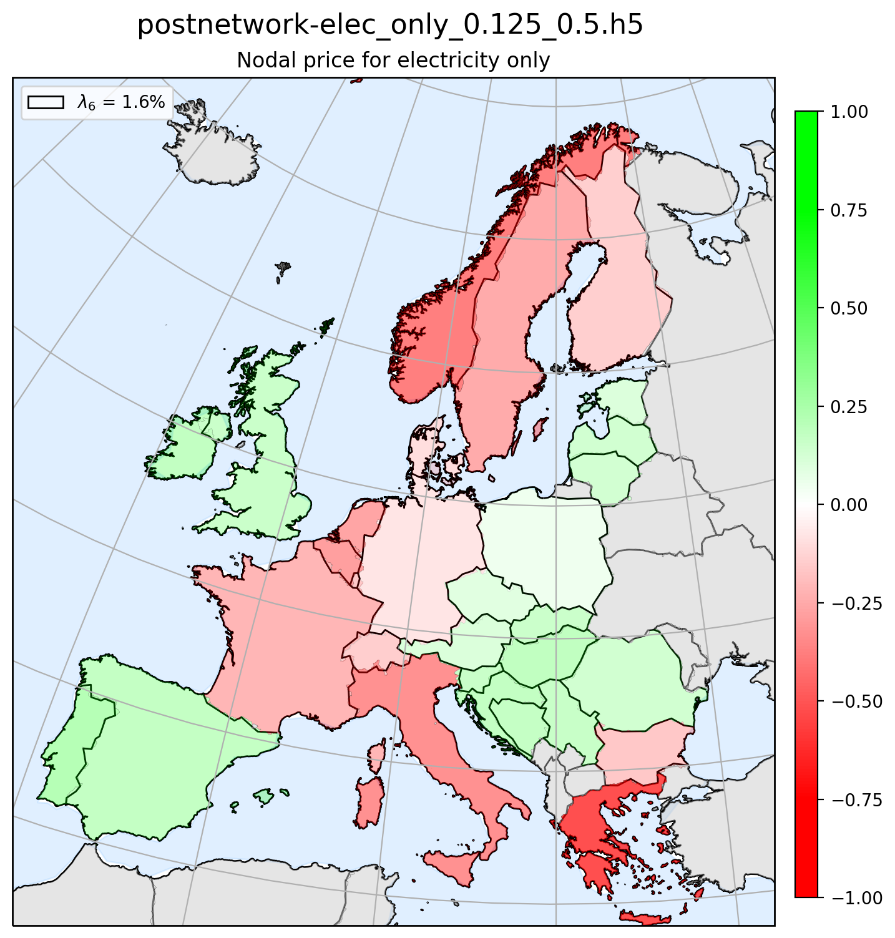
Principal component 6 – Map plot PC

Slide 16
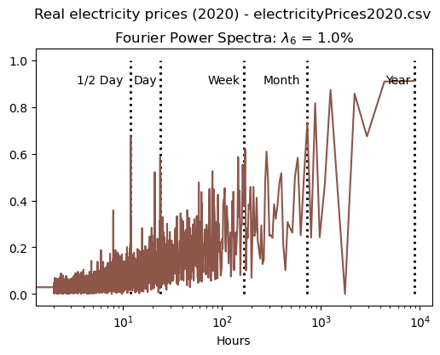
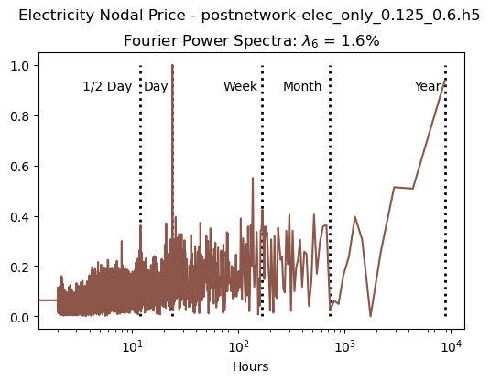

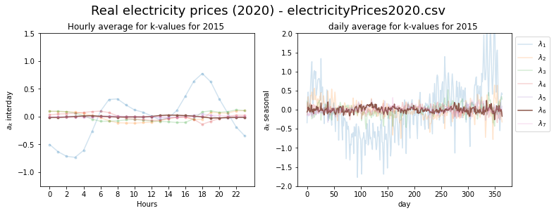
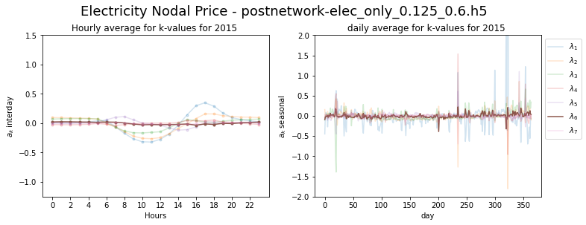

Principal component 6 – FFT and seasonal

Slide 17
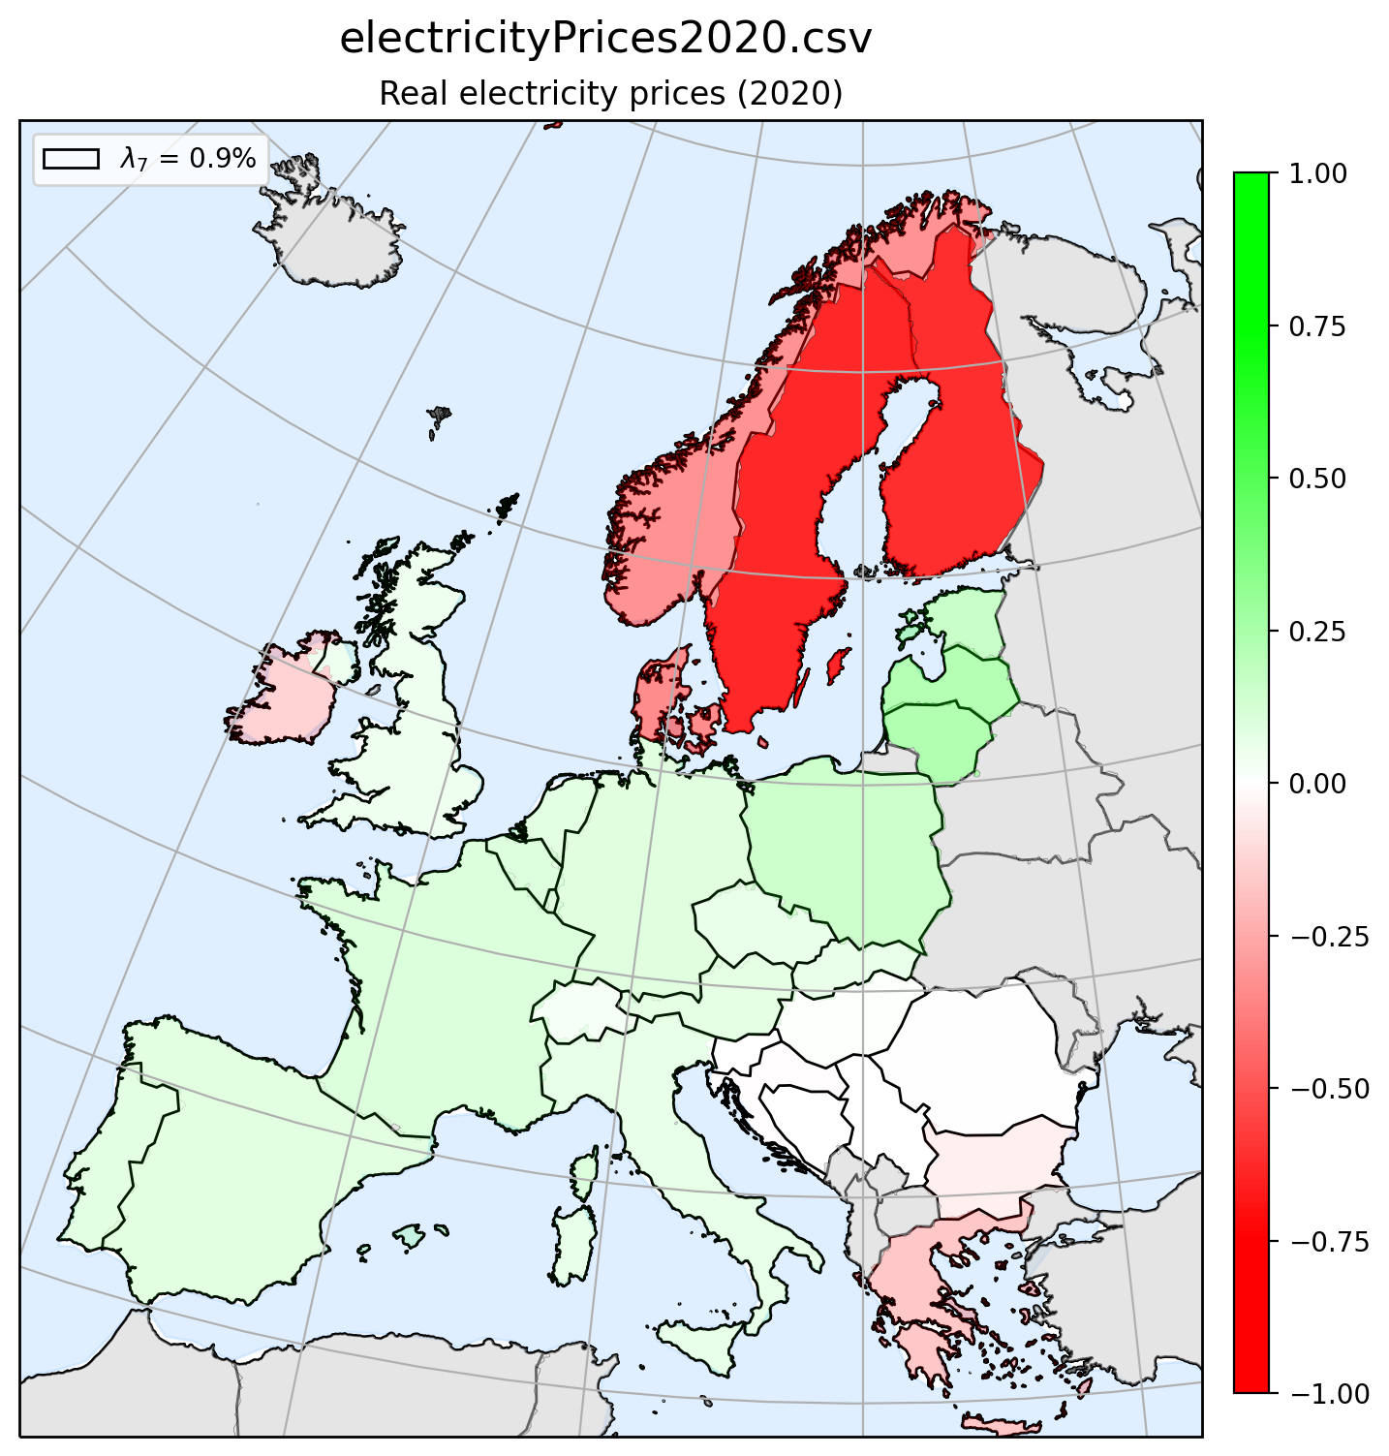
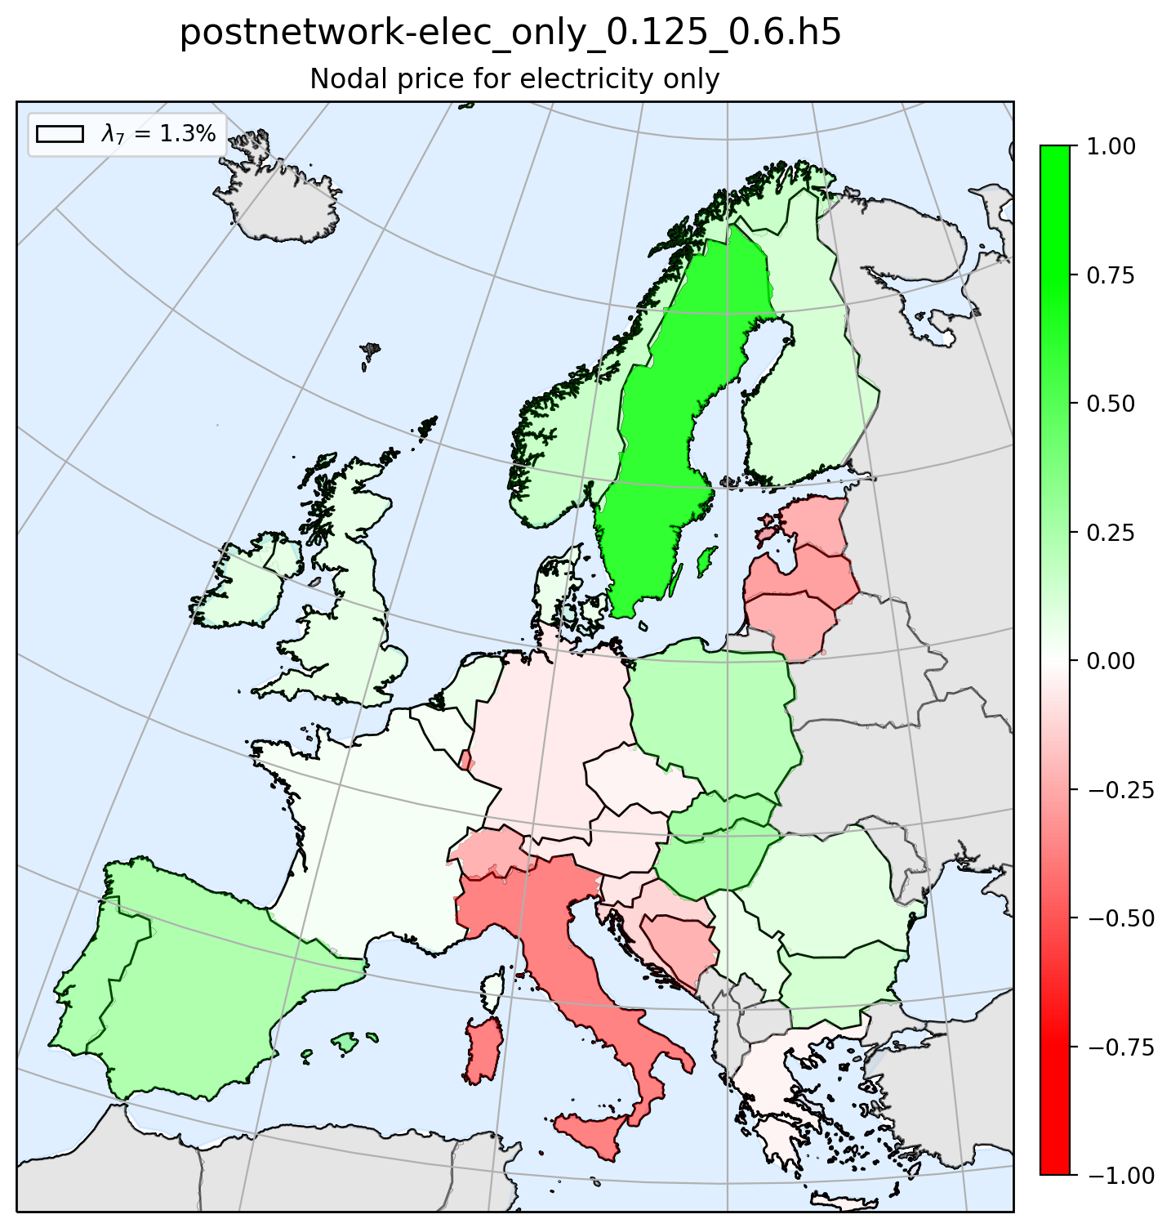

Principal component 7 – Map plot PC

Slide 18
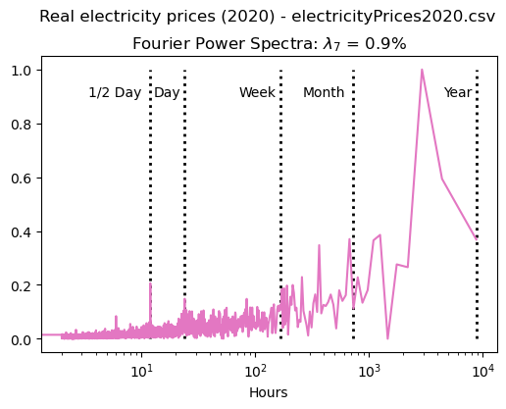
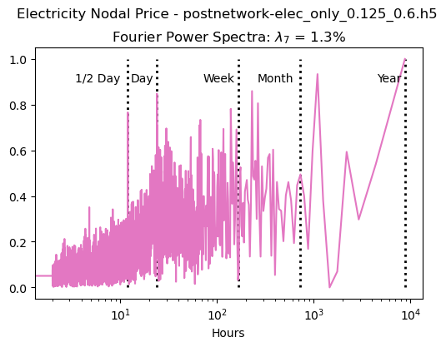

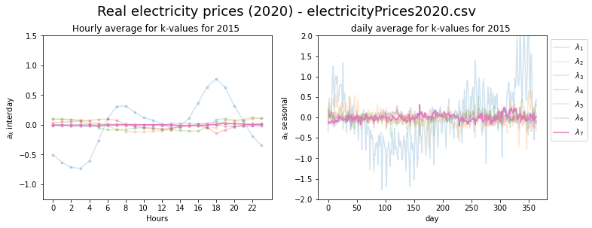
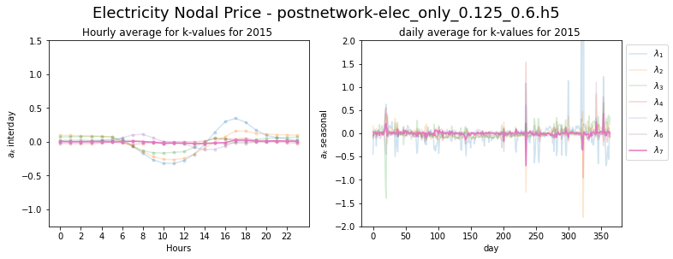
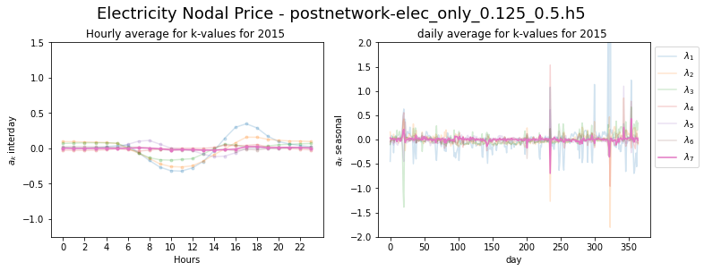
Principal component 7 – FFT and seasonal

Slide 19
Coherence between real ENP and Simulated networks
Real ENP vs. elec_only_0.125_0.6
Real ENP vs. elec_only_0.125_0.5

Slide 20
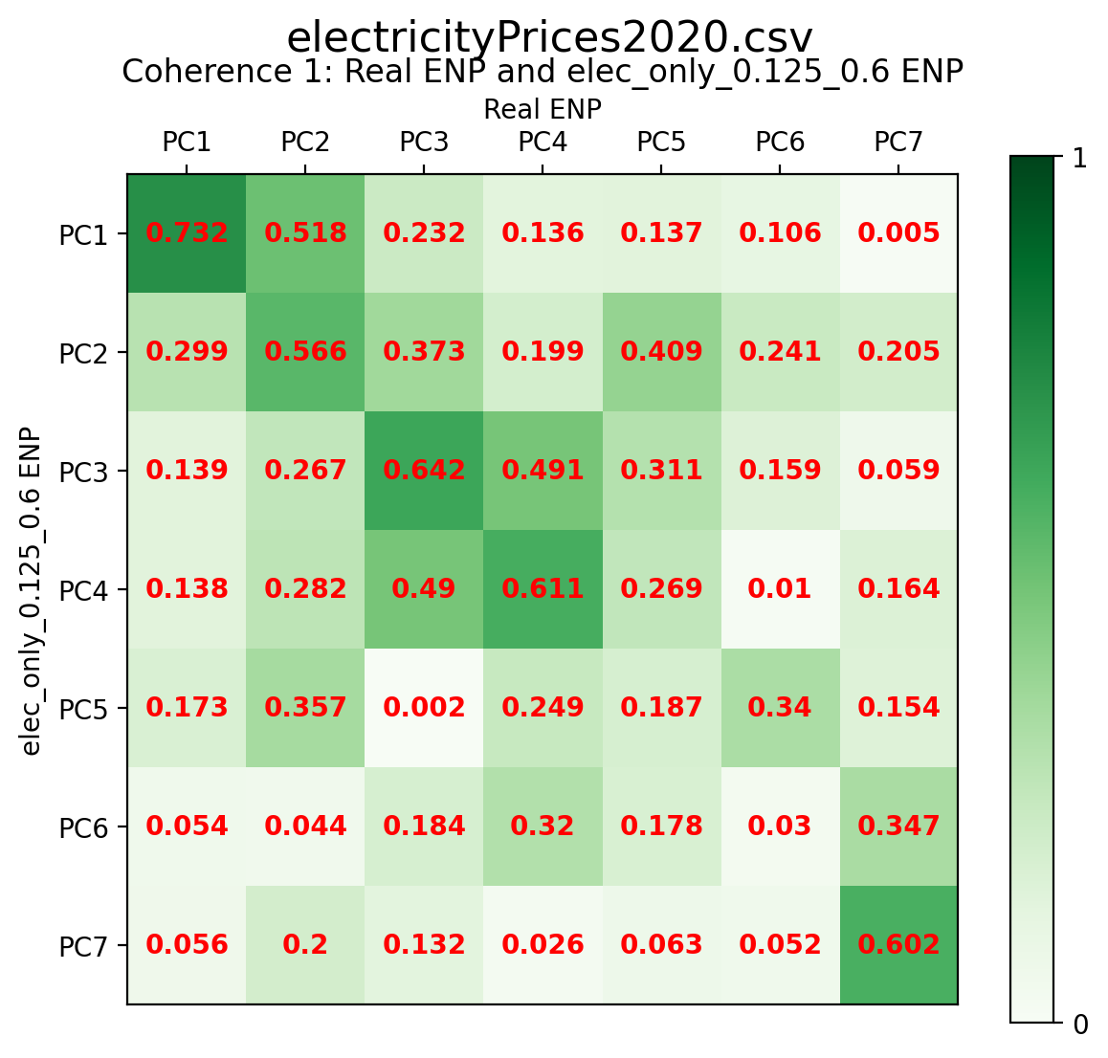

Coherence method 1

Slide 21
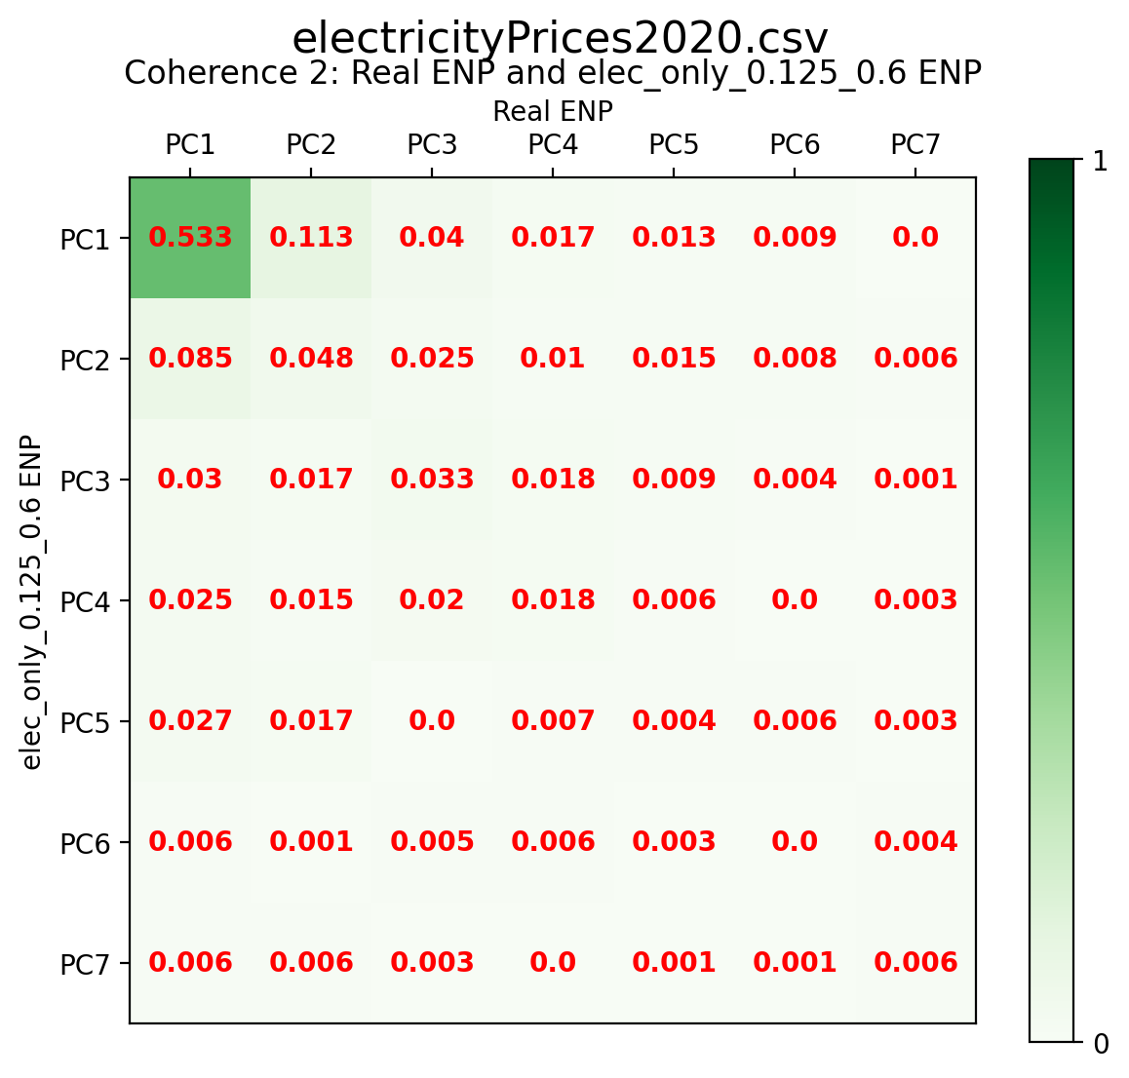

Coherence method 2

Slide 22


Coherence method 3

